Slide 1
UX
Feelings VS Emotion

Slide 2
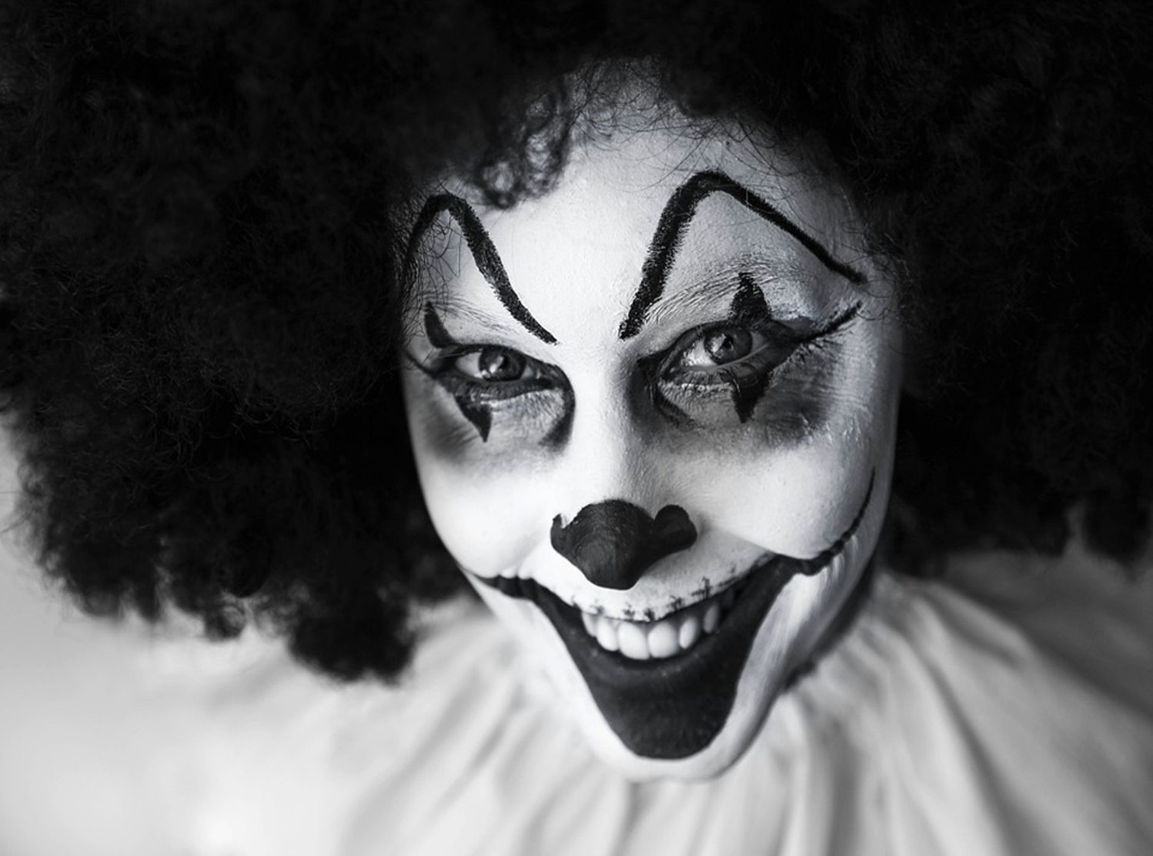
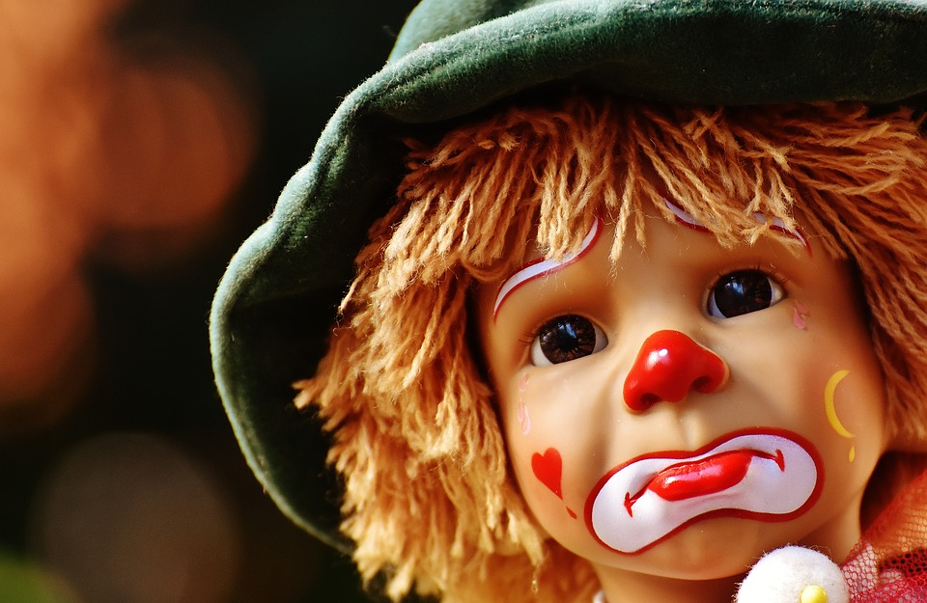
Feelings VS Emotions

Slide 3
In #UX
If you want to gain insights into Users, you should at least be able to identify Feelings, Emotions, Thoughts and Ideas
This knowledge is extremely valuable in qualitative research!

Slide 4
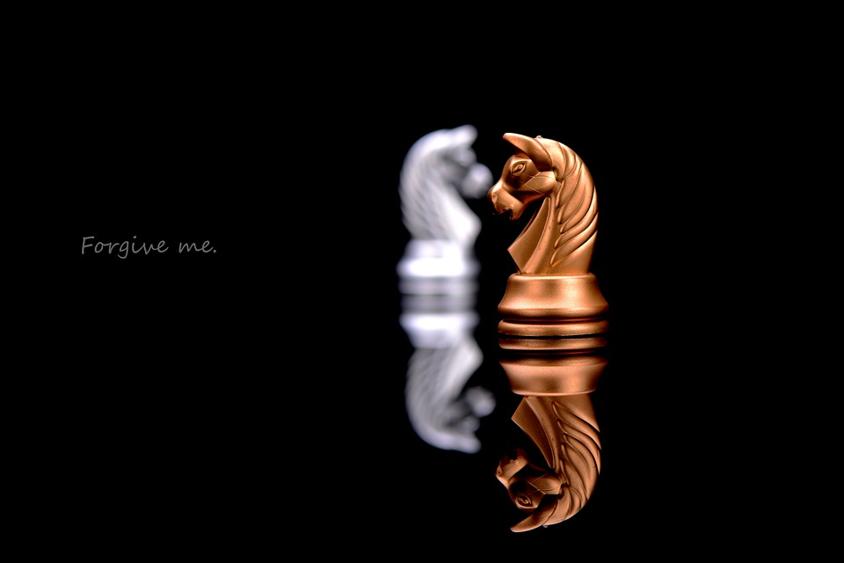
What is the difference between feelings and Emotions?

Slide 5
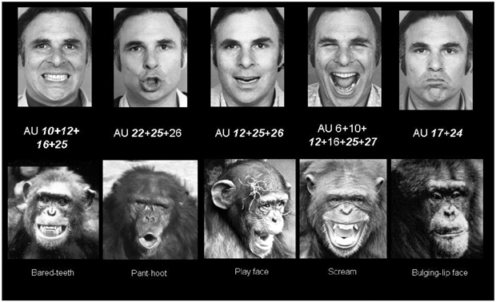
Facial Expressions
Facial Expressions are the most important means of nonverbal communication.
Emotions are communicated via facial expressions.

Slide 6
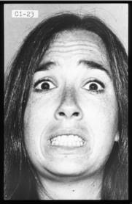
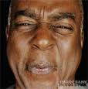
Facial Expressions and Evolution
Why do we have facial expressions?
Facial expressions are vestiges (throwbacks or remnants) of once useful physiological reactions.
Examples: “fear face” enhances perception; “disgust face” decreases perception
Notes:
Source: - TenHouten

Slide 7
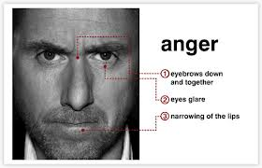
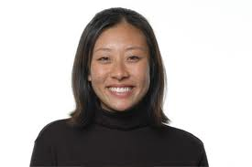
Facial Expressions and Evolution
Why do we have facial expressions?
Facial expressions have survival value b/c they communicate to others our emotional states.
We can more easily detect anger in men; and happiness in women.
Notes:
Source: - TenHouten

Slide 8
Emotions, Feelings, and Moods
Emotions | Feelings
PUBLIC- actions and movements, often in public view | PRIVATE- not revealed in facial expressions or behavior
Emotions | Moods
SHORT-TERM: Acute; immediate; tied to a particular situation | LONG-TERM: Emotions or Feelings of long duration (habitual)
Notes:
Source: - TenHouten

Slide 9
Feelings are felt through immediate experience as a result of outside stimuli (reacting with five physical senses) but no cognitive thought has occurred, your brain is not involved in a feeling, but your body is!
Feelings are prethoughts
Emotions are afterthoughts
Emotions are fabricated through your own thoughts and your memory and reflected in your physical state (Primary emotions), emotion are the physical results after your brain processed the consciousness and spit out a thought,
Intuition operates in the feeling world not the emotional world.
Feelings ae neutral (You feel without judgement from your brain)
When you become emotional about your feelings that when your brain creates drama.

Slide 10
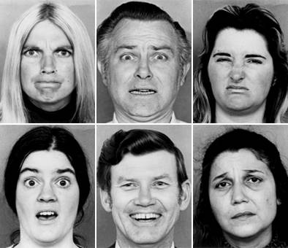
The Primary Emotions
Can you name these emotions?

Slide 11
The Primary Emotions (Robert Plutchiks)
ANGER
FEAR
DISGUST
SURPRISE
HAPINESS
(JOY)
SADNESS
Can you name these emotions?

Slide 12
Primary Emotions
Research suggests that these 6 emotions are universal, i.e. can be encoded (expressed) and decoded (understood) by people across all cultures:
Anger, Happiness, Surprise, Fear, Disgust, Sadness
Other emotions that might be universally recognized include: contempt, pride, and shame.

Slide 13
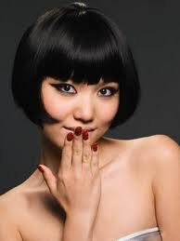
Emotional Expression
Many emotions are universal (all humans possess them), but different cultures have different display rules:
Display rules = culturally determined rules about which nonverbal behaviors are appropriate to display

Slide 14
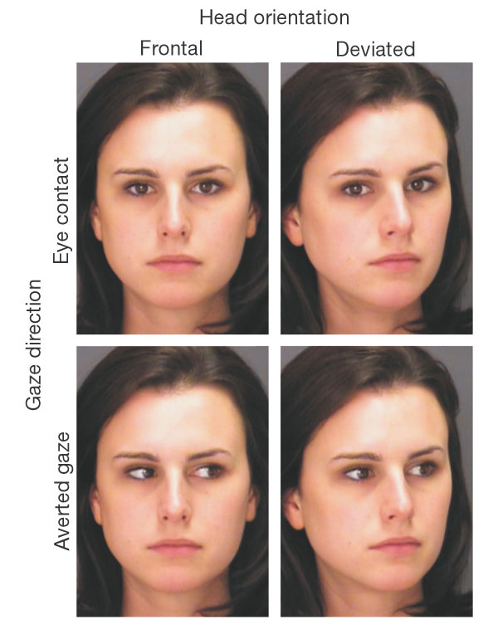
Cultural Differences in Nonverbal Communication
Eye Contact and Gaze:
In Nigeria, Puerto Rico, and Thailand, children are taught to avoid eye contact with superiors
In the Middle East, Arabs often use a lot of eye contact

Slide 15
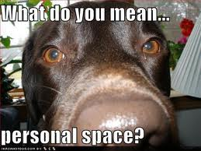
Cultural Differences in Nonverbal Communication
2. Personal Space and touching:
High-contact cultures: stand close to one another and touch frequently; Middle East, South America, Southern Europe
Low-contact cultures include: North America, Asian, Pakistani and some Native American peoples

Slide 16
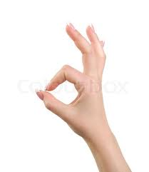

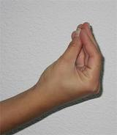
Cultural Differences in Nonverbal Communication
Hand Gestures:
“OK” Sign: In Japan = ‘money’; in Mexico =‘sex’; in Brazil = the middle finger
Thumbs-up: Japan = ‘boyfriend’; Iran = obscene
Hand-purse gesture: no meaning in the US; but in Italy means ‘What are you trying to say?’; in Tunisia it means ‘slow down’; in Malta means ‘you may seem good, but you are really bad.’
Nodding head: in some parts of Africa and India, up and down mean ‘NO’ and side to side means ‘YES’; in Korea, side to side means ‘I don’t know’

Slide 17

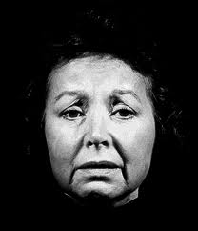
Joy and Sadness
Joy is a foreground, acute emotion; happiness, a background baseline sentiment.
Happy people are: less self-focused, less hostile and abusive, less vulnerable to disease, more loving, trusting, forgiving, creative, energetic, decisive, helpful, and sociable.
The Opposite of happiness is NOT unhappiness, but misery and loneliness (31).
Sadness, Grief, Loneliness: separation or loss of attachment to a source of joy, loss of security, loss of excitement.
Notes:
Note: there is no consensus that sadness is the opposite of Joy/Happiness; for example Plutchik calls the opposite of joy "Distress", with sadness being just one form.

Slide 18
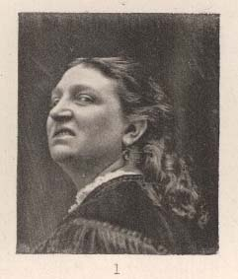
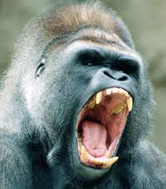
Anger and Fear
Anger
Anger "is usually an immediate, spontaneous response to the perception of unjustifed harm or pain to the self or to one's family members, friends, or acquaintances" (41)
Concerns depreciation of worth and status in a group
Anger is not present at birth.
Anger appears during first 5-6 months in order to remove obstacles and obstructions
Associated with direct manipulation of objects.
Notes:
Sources: TenHouten (2000)

Slide 19
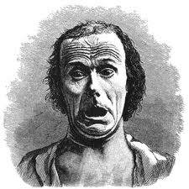

Anger and Fear
Anger
Behavior = moving towards an object; anger can be a potential component of rational decision making.
Dominant persons don’t necessarily display anger; usually those who are insecure display anger; but can also be an appropriate defense against the assertions of power by other people.
Terror and agony

Slide 20

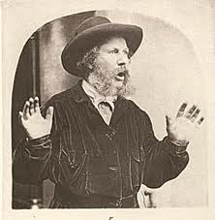
Anticipation and Surprise
Anticipation = interest, exploration. An orientation towards the future; expectation.
Surprise: Surprise is an orienting response; an adaptive behavior geared towards rapidly identifying the cause of something.
Levels of intensity: sudden attention → astonishment → stupified amazement
Secondary emotions:
happy surprise = delight
unhappy surprise = disappointment
angry surprise = aggression
accepting surprise = curiosity

Slide 21
Secondary Emotions
8 primary dyads:
Love = acceptance & joy
Misery, loneliness = disgust & sadness
Pride = anger & joy
Embarrassment = fear & sadness
Aggression = anger & anticipation
Alarm, awe = fear & surprise
Curiosity = surprise & acceptance
Cynicism = anticipation & disgust

Slide 22
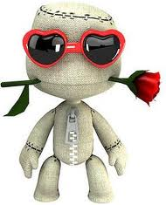
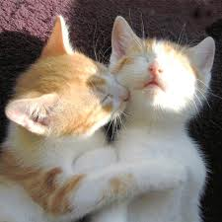
Love (a secondary emotion)
"Love is the joyful acceptance of another" (52); Love = acceptance and joy.
Falling in Love entails the creation of a new community, a collective social movement.
Love is a revolutionary force, subverts previous ties; extinguishes alienation
Similar to Durkheim's notion of 'collective effervescence‘.
Love generates mental experience of eternalization of the present (54)
Requires an obstacle
Notes:
"Without an obstacle of some kind, be it the family, social class, present spouse, ethnic or linguistic group membership, without some bond being tested or severed, there will be no falling in love" (54)

Slide 23
Tertiary Emotions (This list is not exhaustive!)
Jealousy = surprise + fear + sadness
Envy = surprise + anger + sadness
Ambition = anticipation + anger + joy
Confidence = anticipation + acceptance + anger
Hope = anticipation + joy + sadness

Slide 24
Plutchik's Wheel of Emotions
Robert Plutchik's theory says that the eight basic emotions are:
Fear → feeling afraid. Other words are terror (strong fear), shock, phobia
Anger → feeling angry. A stronger word is rage.
Sadness → feeling sad. Other words are sorrow, grief (a stronger feeling, for example when someone has died) or depression (feeling sad for a long time). Some people think depression is a different emotion.
Joy → feeling happy. Other words are happiness, gladness.
Disgust → feeling something is wrong or dirty
Trust → a positive emotion; admiration is stronger; acceptance is weaker
Anticipation → in the sense of looking forward positively to something which is going to happen. Expectation is more neutral.
Surprise → how one feels when something unexpected happens

Slide 25
Can you categorise the following into Feelings and Emotions
Happiness | Anger
Fear Joy | Enthusiasm
Lust | Contentment
Bitterness | Worry
Love | Sadness
 | Depression

Slide 26
Happiness: is a feeling. | Joy: is an emotion.
Worry: is a feeling. | Fear: is an emotion.
Contentment: is a feeling. | Enthusiasm: is an emotion.
Bitterness: is a feeling. | Anger: is an emotion.
Love: is a feeling. | Lust: is an emotion.
Depression: is a feeling. | Sadness: is an emotion.

Slide 27
emoticon

